Slide 1
Newton’s method in n dimensions

Slide 2
Introduction
In this topic, we will
Derive Newton’s method in n dimensions
Observe the formula is analogous to the one we’ve seen
Look at an example
Observe the rate of convergence is still O(h²)

Slide 3
Newton’s method
Recall Newton’s method:
Find the root of the tangent line at (x_{k}, f (x_{k}))
f (x)
x_{k}

Slide 4
Generalization of Newton’s method
Recall the Taylor series for a real-valued function of a vector variable
Suppose we have n such functions, so for each we have:

Slide 5
Generalization of Newton’s method
Thus, we have:

Slide 6
Generalization of Newton’s method
Thus, we have:
This is the Jacobian evaluated at u₀

Slide 7
Generalization of Newton’s method
Thus, we have n tangent (n – 1)-dimensional hyperplanes at u₀:
A root of these hyperplanes may be found by equating this to the zero vector:
This is a system of n linear equations in n unknowns
Let Δu₀ = u – u₀, so we are solving
Having found Δu₀, we now assign u₁ ← u₀ + Δu₀
We can now repeat this until and

Slide 8
Generalization of Newton’s method
You may be wondering, how are these related?
Solve for Δu_{k},
and assign u_{k+1} ← u_{k} + Δu_{k}
That is,

Slide 9
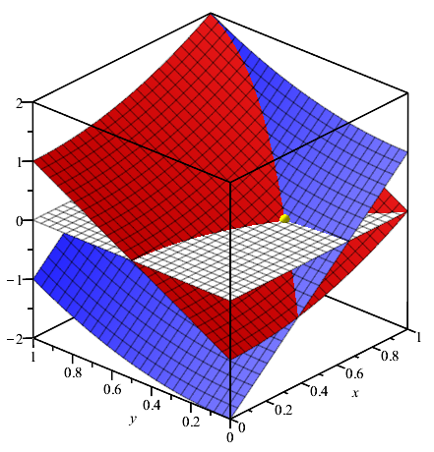
Example
Suppose we have the following:

Slide 10
Example
First, we calculate the Jacobian

Slide 11
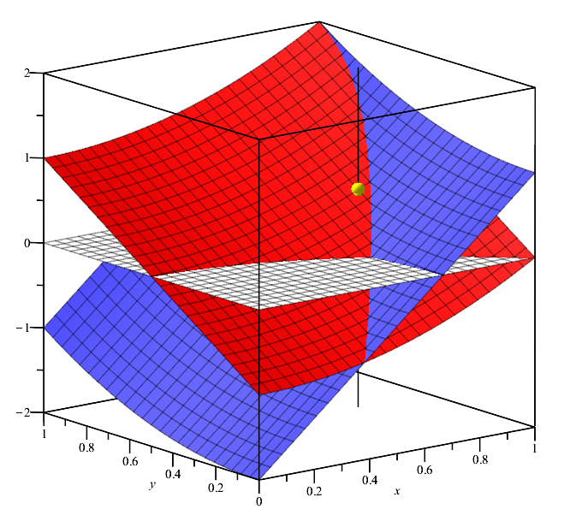
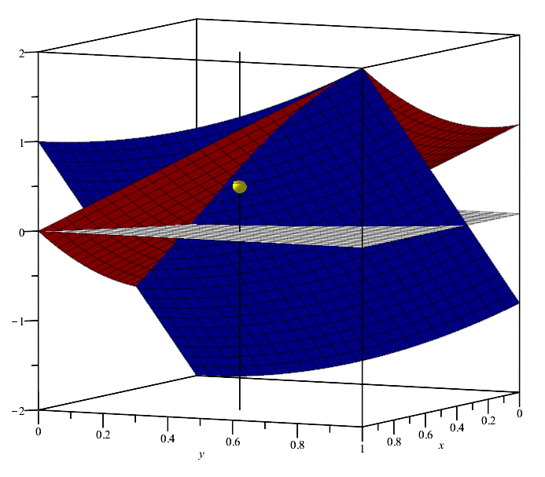
Example
Note that
Thus, is sort-of close to a root

Slide 12
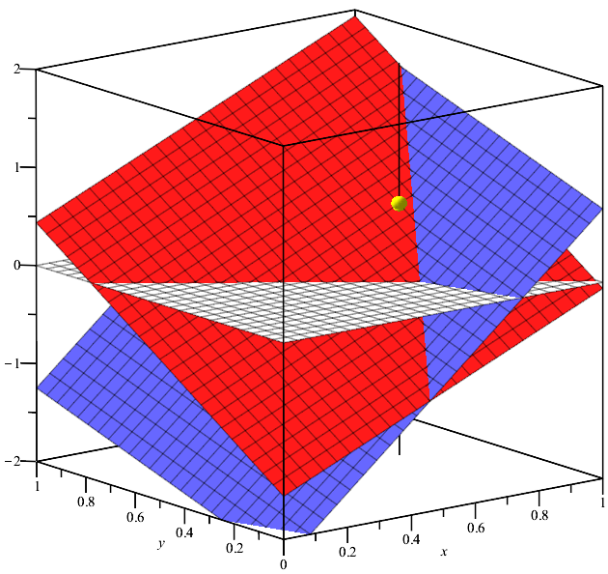
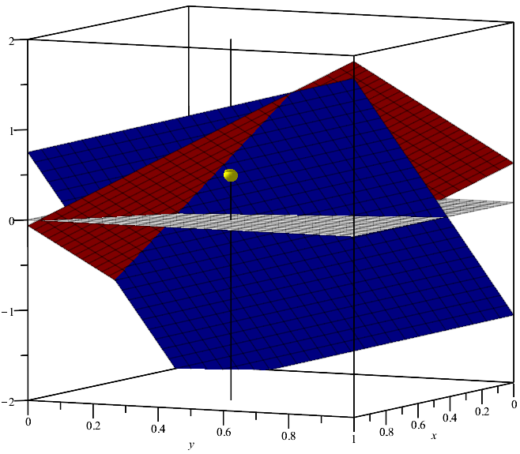
Example
We can find tangent planes at each of these points

Slide 13
Example
We solved for Δu₀ and so u₁ ← u₀ + Δu₀
Thus, and

Slide 14
Example
Here is a sequence of iterations:

Slide 15
Example
The actual root is closer to

Slide 16
Summary
Following this topic, you now
Understand the generalization of Newton’s method
In two dimensions, we have two expressions in two variables
Given an initial approximation, find two tangent planes, and find the simultaneous root of those tangent planes
Know this generalizes to n dimensions
Find the tangent hyper-planes and find the root of the tangent hyper-planes
Are aware that the convergence is still O(h²)

Slide 17
References
[1] https://en.wikipedia.org/wiki/Newton%27s_method

Slide 18
Acknowledgments
Jeffrey Cornelis for noting I left out the most significant digit in the leading entry of the approximation

Slide 19
Colophon
These slides were prepared using the Cambria typeface. Mathematical equations use Times New Roman, and source code is presented using Consolas. Mathematical equations are prepared in MathType by Design Science, Inc.
Examples may be formulated and checked using Maple by Maplesoft, Inc.
The photographs of flowers and a monarch butter appearing on the title slide and accenting the top of each other slide were taken at the Royal Botanical Gardens in October of 2017 by Douglas Wilhelm Harder. Please see
https://www.rbg.ca/
for more information.

Slide 20
Disclaimer
These slides are provided for the ece 204 Numerical methods course taught at the University of Waterloo. The material in it reflects the author’s best judgment in light of the information available to them at the time of preparation. Any reliance on these course slides by any party for any other purpose are the responsibility of such parties. The authors accept no responsibility for damages, if any, suffered by any party as a result of decisions made or actions based on these course slides for any other purpose than that for which it was intended.

